Slide 1
Global Terrorism Analysis
Aakash Tandel
General Assembly DC, Data Science Immersive

Slide 2
Overview
Database
Exploratory Data Analysis
Bayesian Analysis
Missing Data

Slide 3



Global Terrorism Database
Overview of the GTD
The Global Terrorism Database (GTD) is an open-source database including information on terrorist events around the world from 1970 through 2016 (with additional annual updates planned for the future). Unlike many other event databases, the GTD includes systematic data on domestic as well as transnational and international terrorist incidents that have occurred during this time period and now includes more than 170,000 cases. For each GTD incident, information is available on the date and location of the incident, the weapons used and nature of the target, the number of casualties, and--when identifiable--the group or individual responsible.
Statistical information contained in the Global Terrorism Database is based on reports from a variety of open media sources. Information is not added to the GTD unless and until we have determined the sources are credible. Users should not infer any additional actions or results beyond what is presented in a GTD entry and specifically, users should not infer an individual associated with a particular incident was tried and convicted of terrorism or any other criminal offense. If new documentation about an event becomes available, an entry may be modified, as necessary and appropriate.
Maintained by the National Consortium for the Study of Terrorism and Responses to Terrorism (START) at the University of Maryland
Years 1970-2016
170,000+ attacks

Slide 4
Exploratory Data Analysis

Slide 5
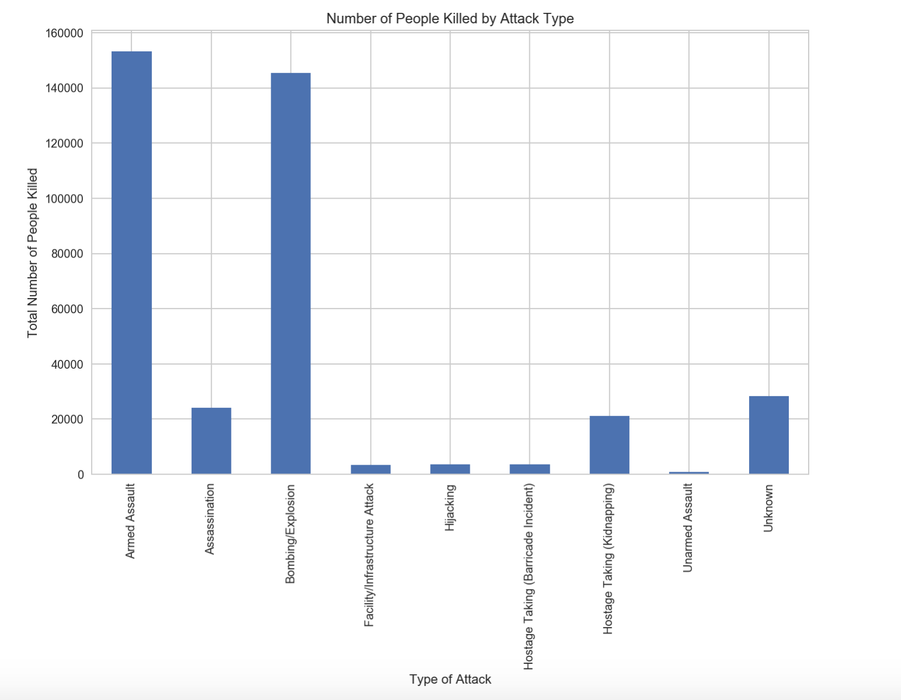
Types of Attacks
Total number of fatalities from 1970-2016
Bombings and Explosions
Armed Assaults

Slide 6
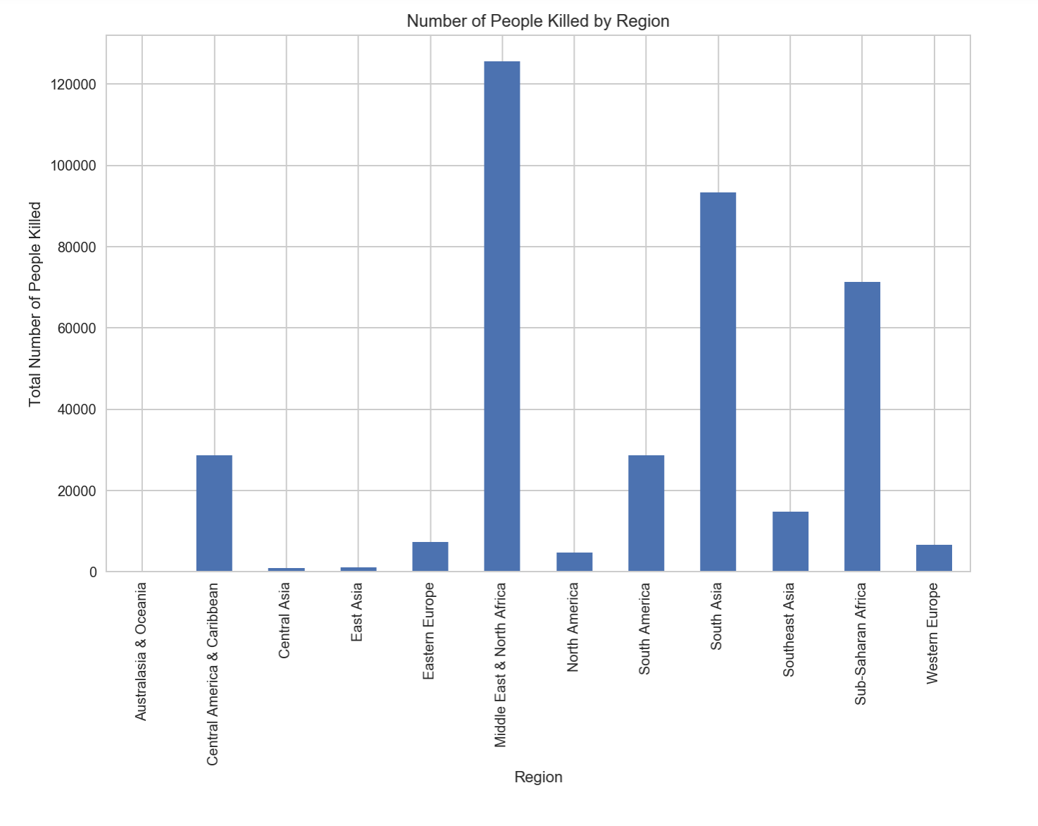
Regions Hardest Hit
Total number of fatalities from 1970-2016
Middle East & North Africa
South Asia

Slide 7

Philippines and Marawi City
Ongoing Battle of Marawi
Philippine Government Security Forces
Abu Sayyaf - pledged to ISIS in 2014
Mauta group

Slide 8
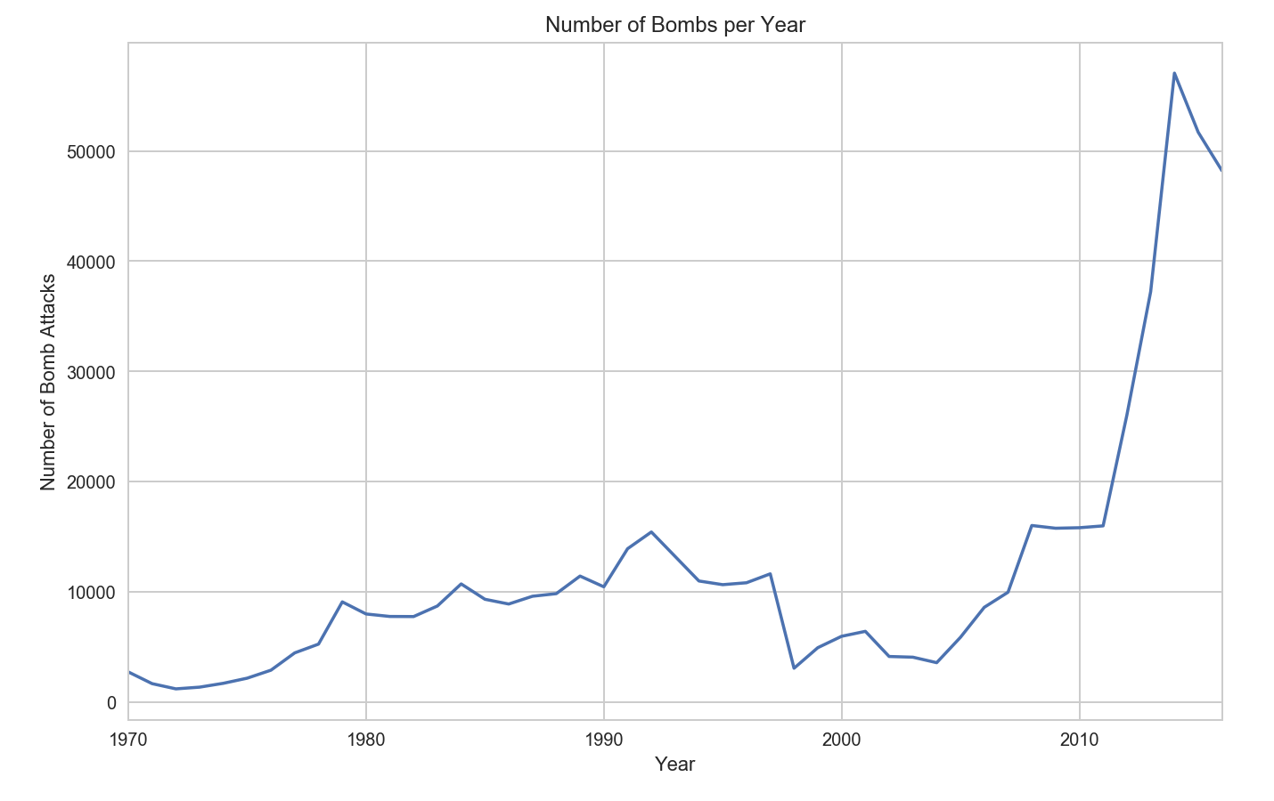
Number of Bombings per Year
Number of fatalities from 1970-2016
Spike after 2010

Slide 9
Bayesian Analysis
Objective: determine whether or not the Philippines saw the same spike in terrorism after 2010

Slide 10
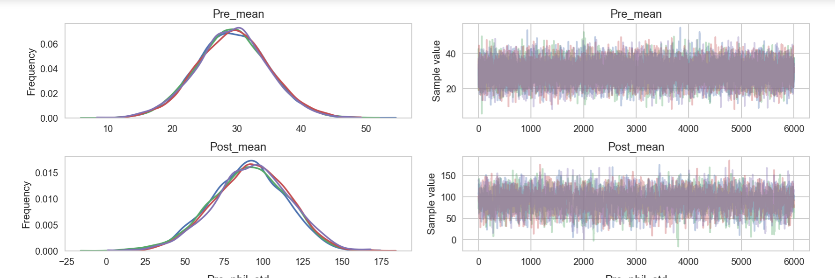
Prior: on average between 1970 and 2009 there were 29 bombings per year in the Philippines

Slide 11
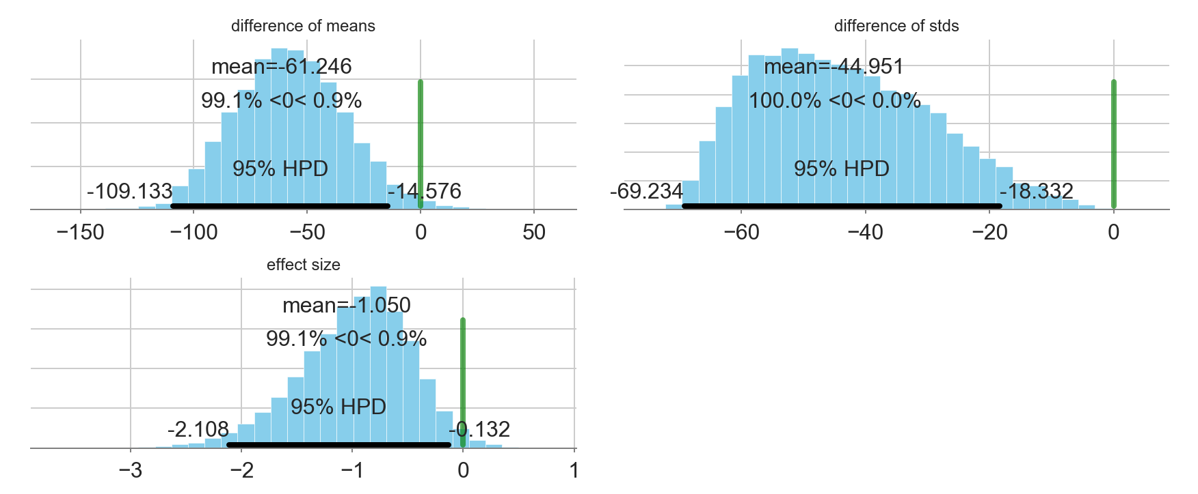
Conclusion: the difference in means between pre-2010 and post-2010 bombings in the Philippines was statistically significant

Slide 12
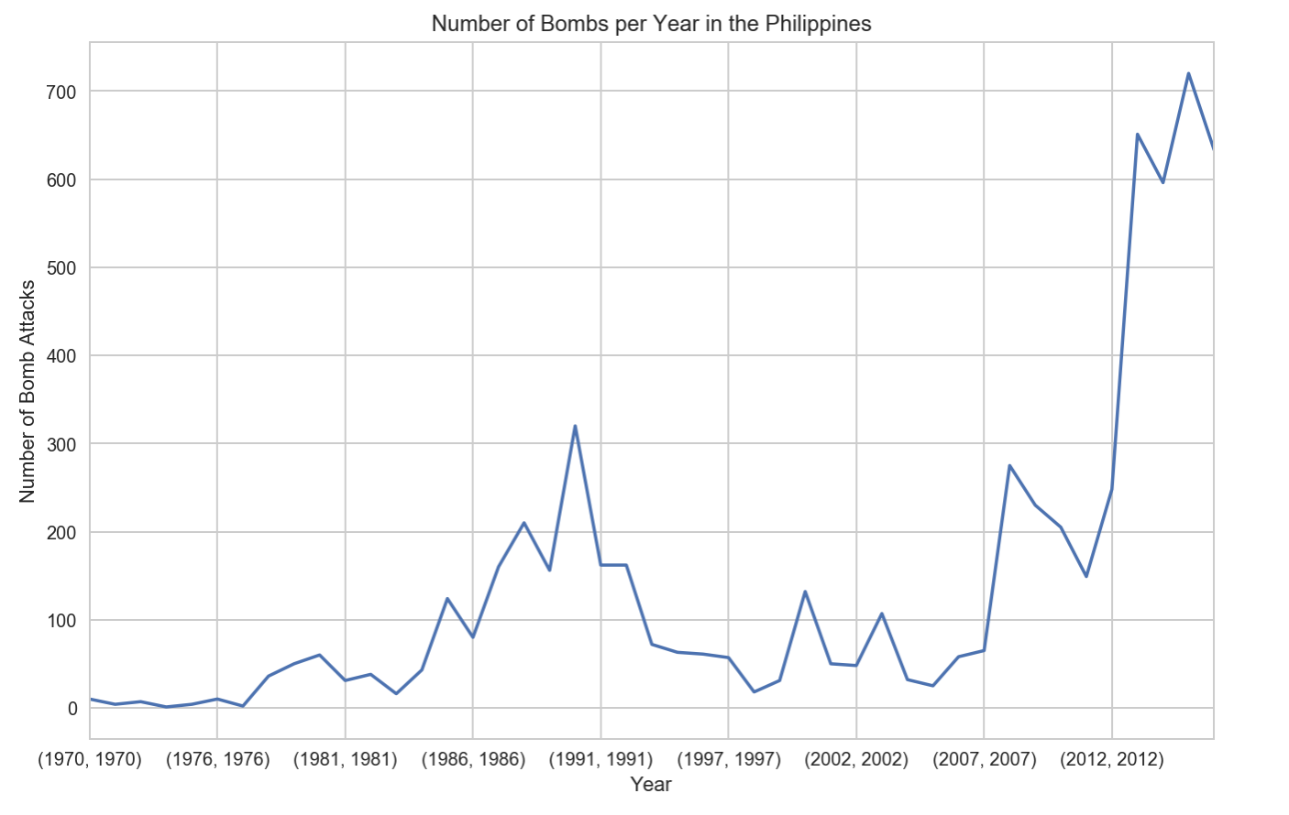

Slide 13
Missing Data: 1993

Slide 14
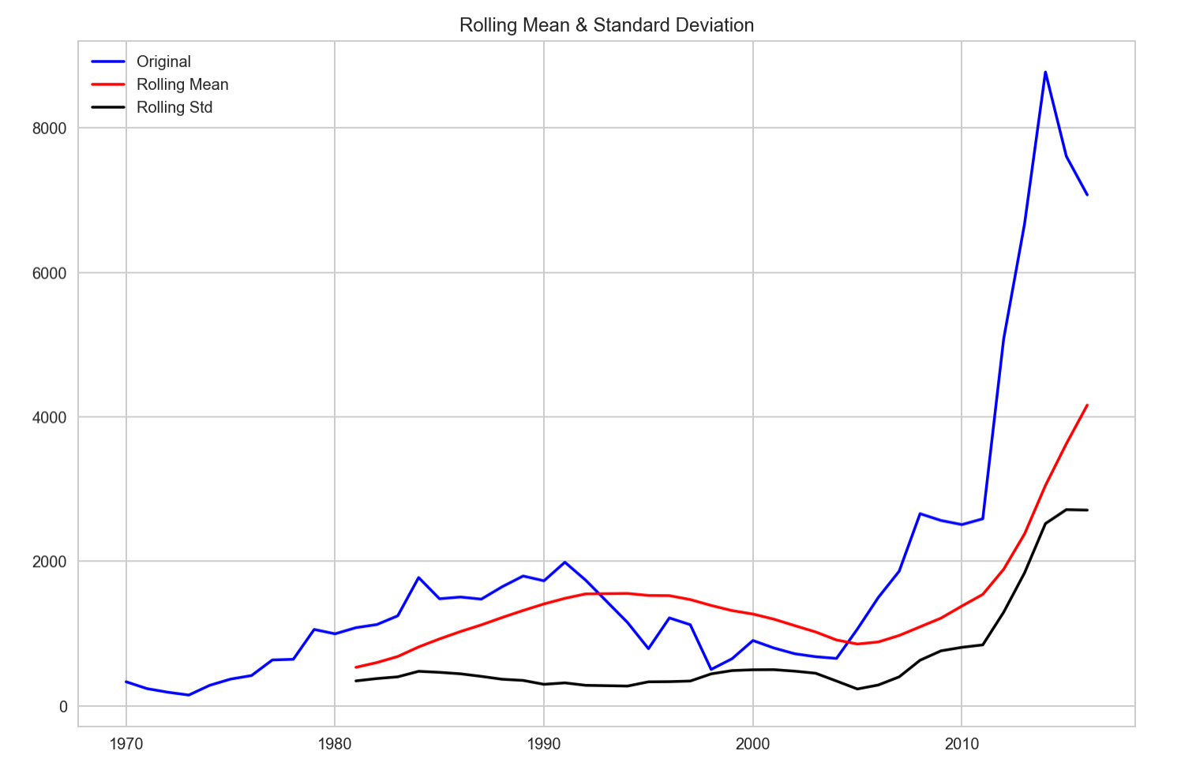
Number of Bombings per Year
Yearly Rolling Mean
Non-stationary Process

Slide 15
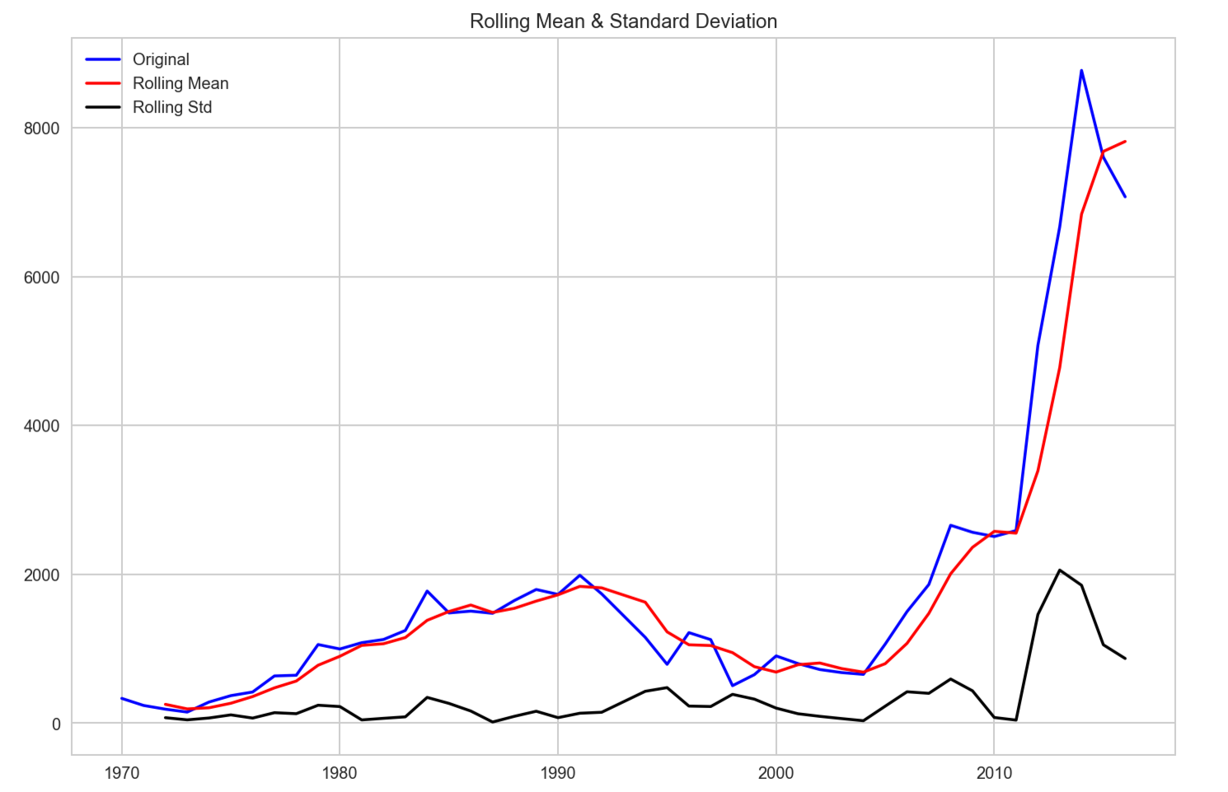
Number of Bombings per Year
Quarterly Rolling Mean
Non-stationary Process
1720 Bombings in 1993
1992 1819.000000 1994 1626.333333

Slide 16
Conclusions
Uptick in bombings since 2010
The Philippines have seen a significant increase in the number of bombings since 2010

Slide 17
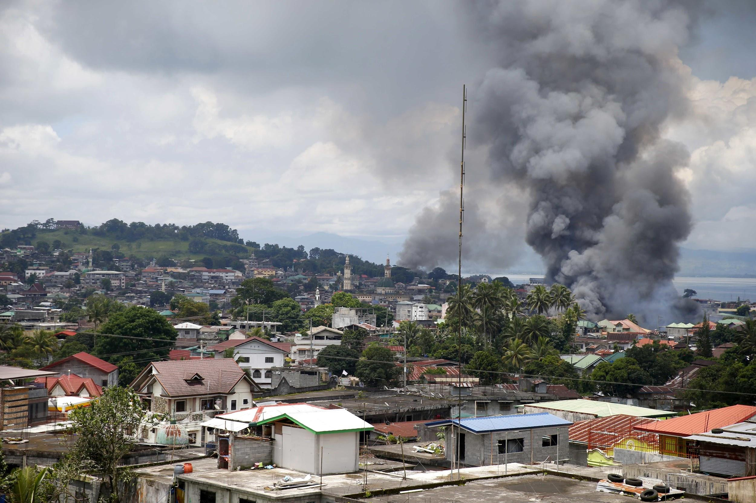
Questions?

